Slide 1

ECE 419/619 Electric Machines and Drives Dc Drives

Slide 2
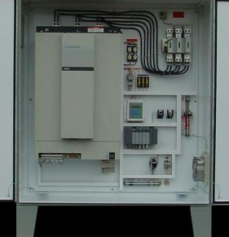
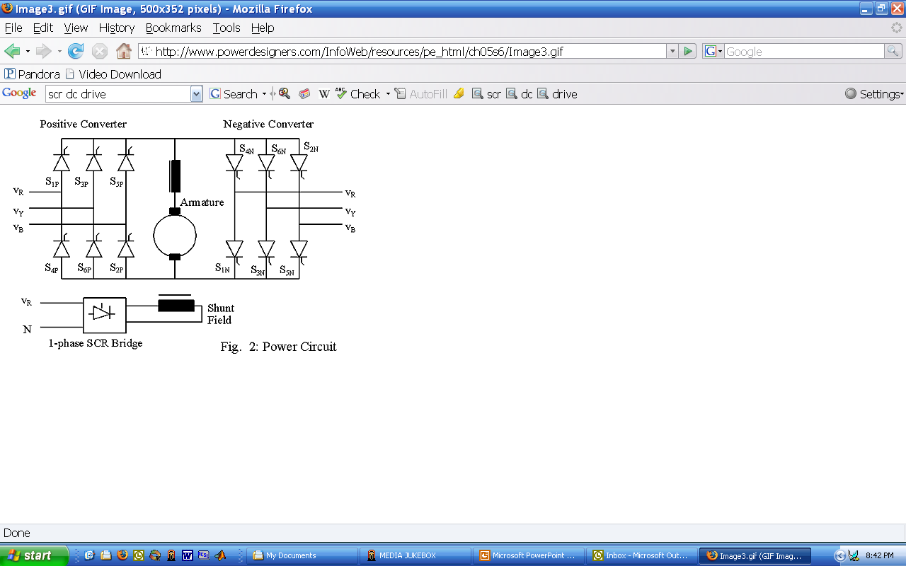
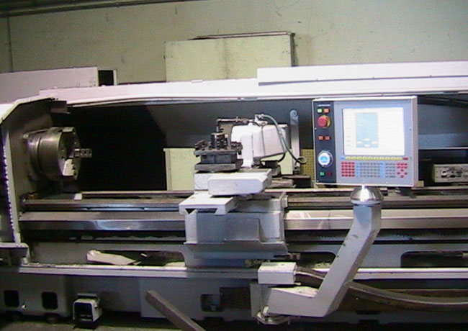
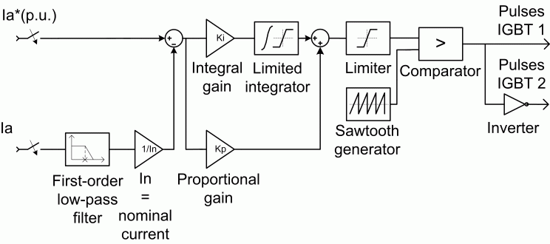
Dc Motor Drives (Chapters 11 and 12)
SCR based drives
Switch at line frequency (typically 60-Hz)
Good for higher voltage and higher power applications
PWM (IGBT or MOSFET) based drives
Higher switching frequency (in the kHz range)
Good for control applications (servo drives)

Slide 3
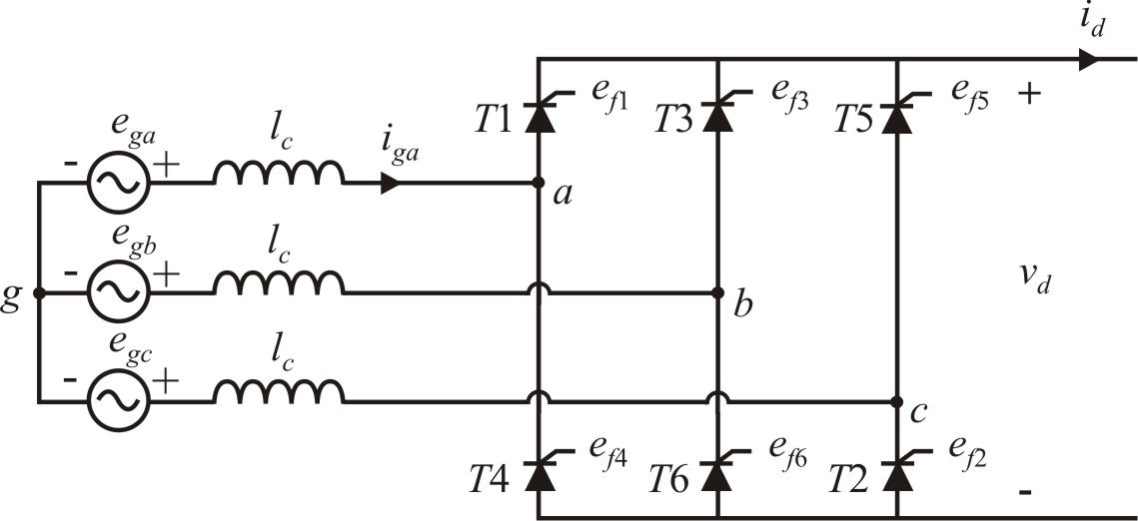
SCR Bridge Converter (Chapter 11)

Slide 4
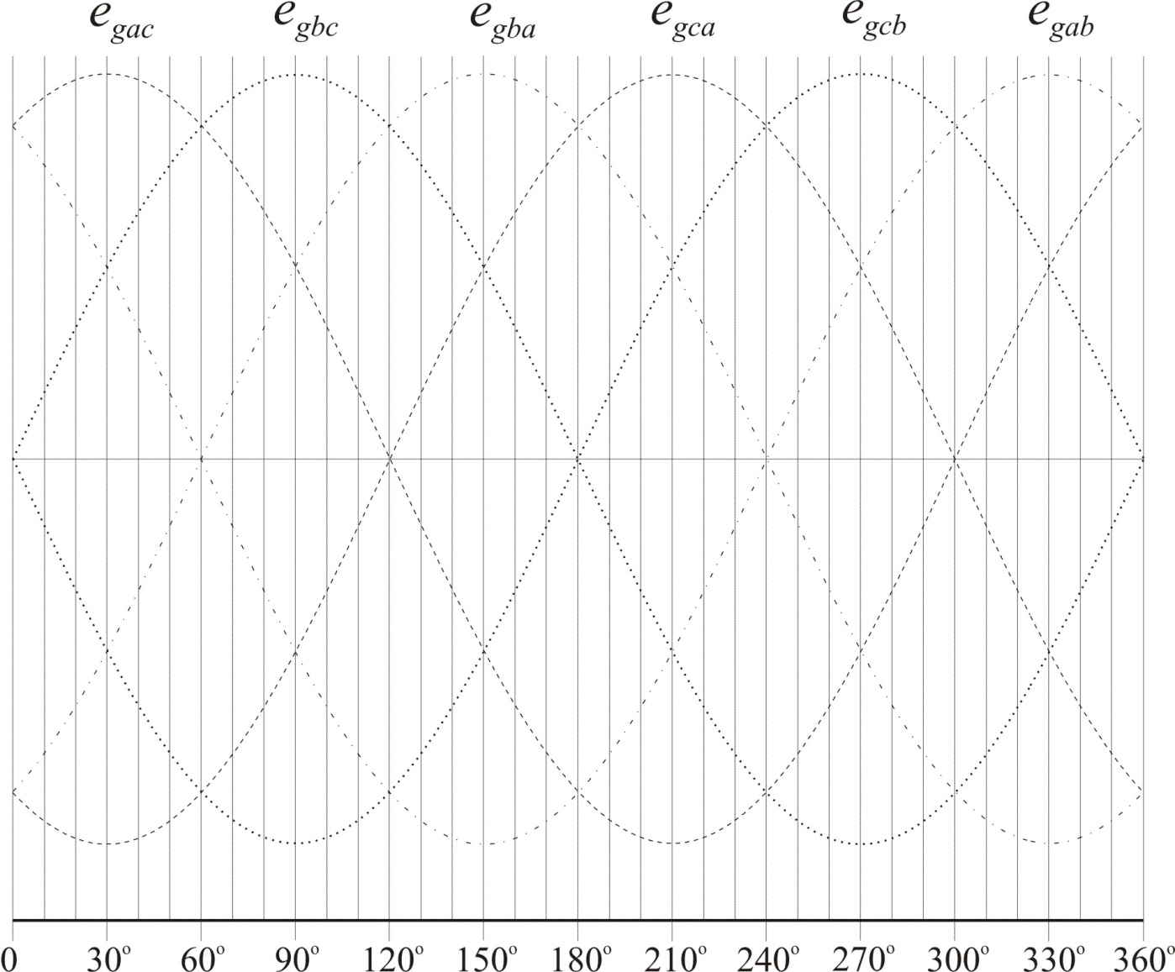
Operation Without Phase Delay and l_{c}=0

Slide 5
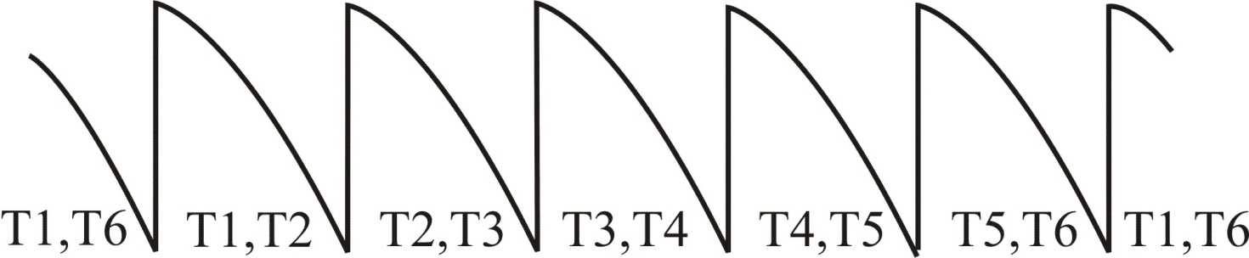
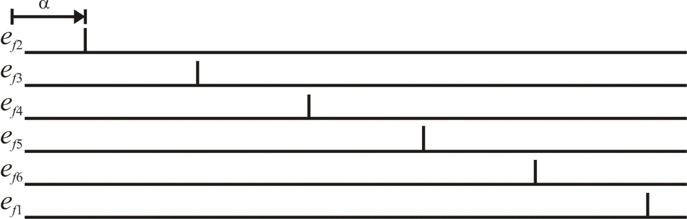
Operation with Phase Delay and l_{c}=0

Slide 6
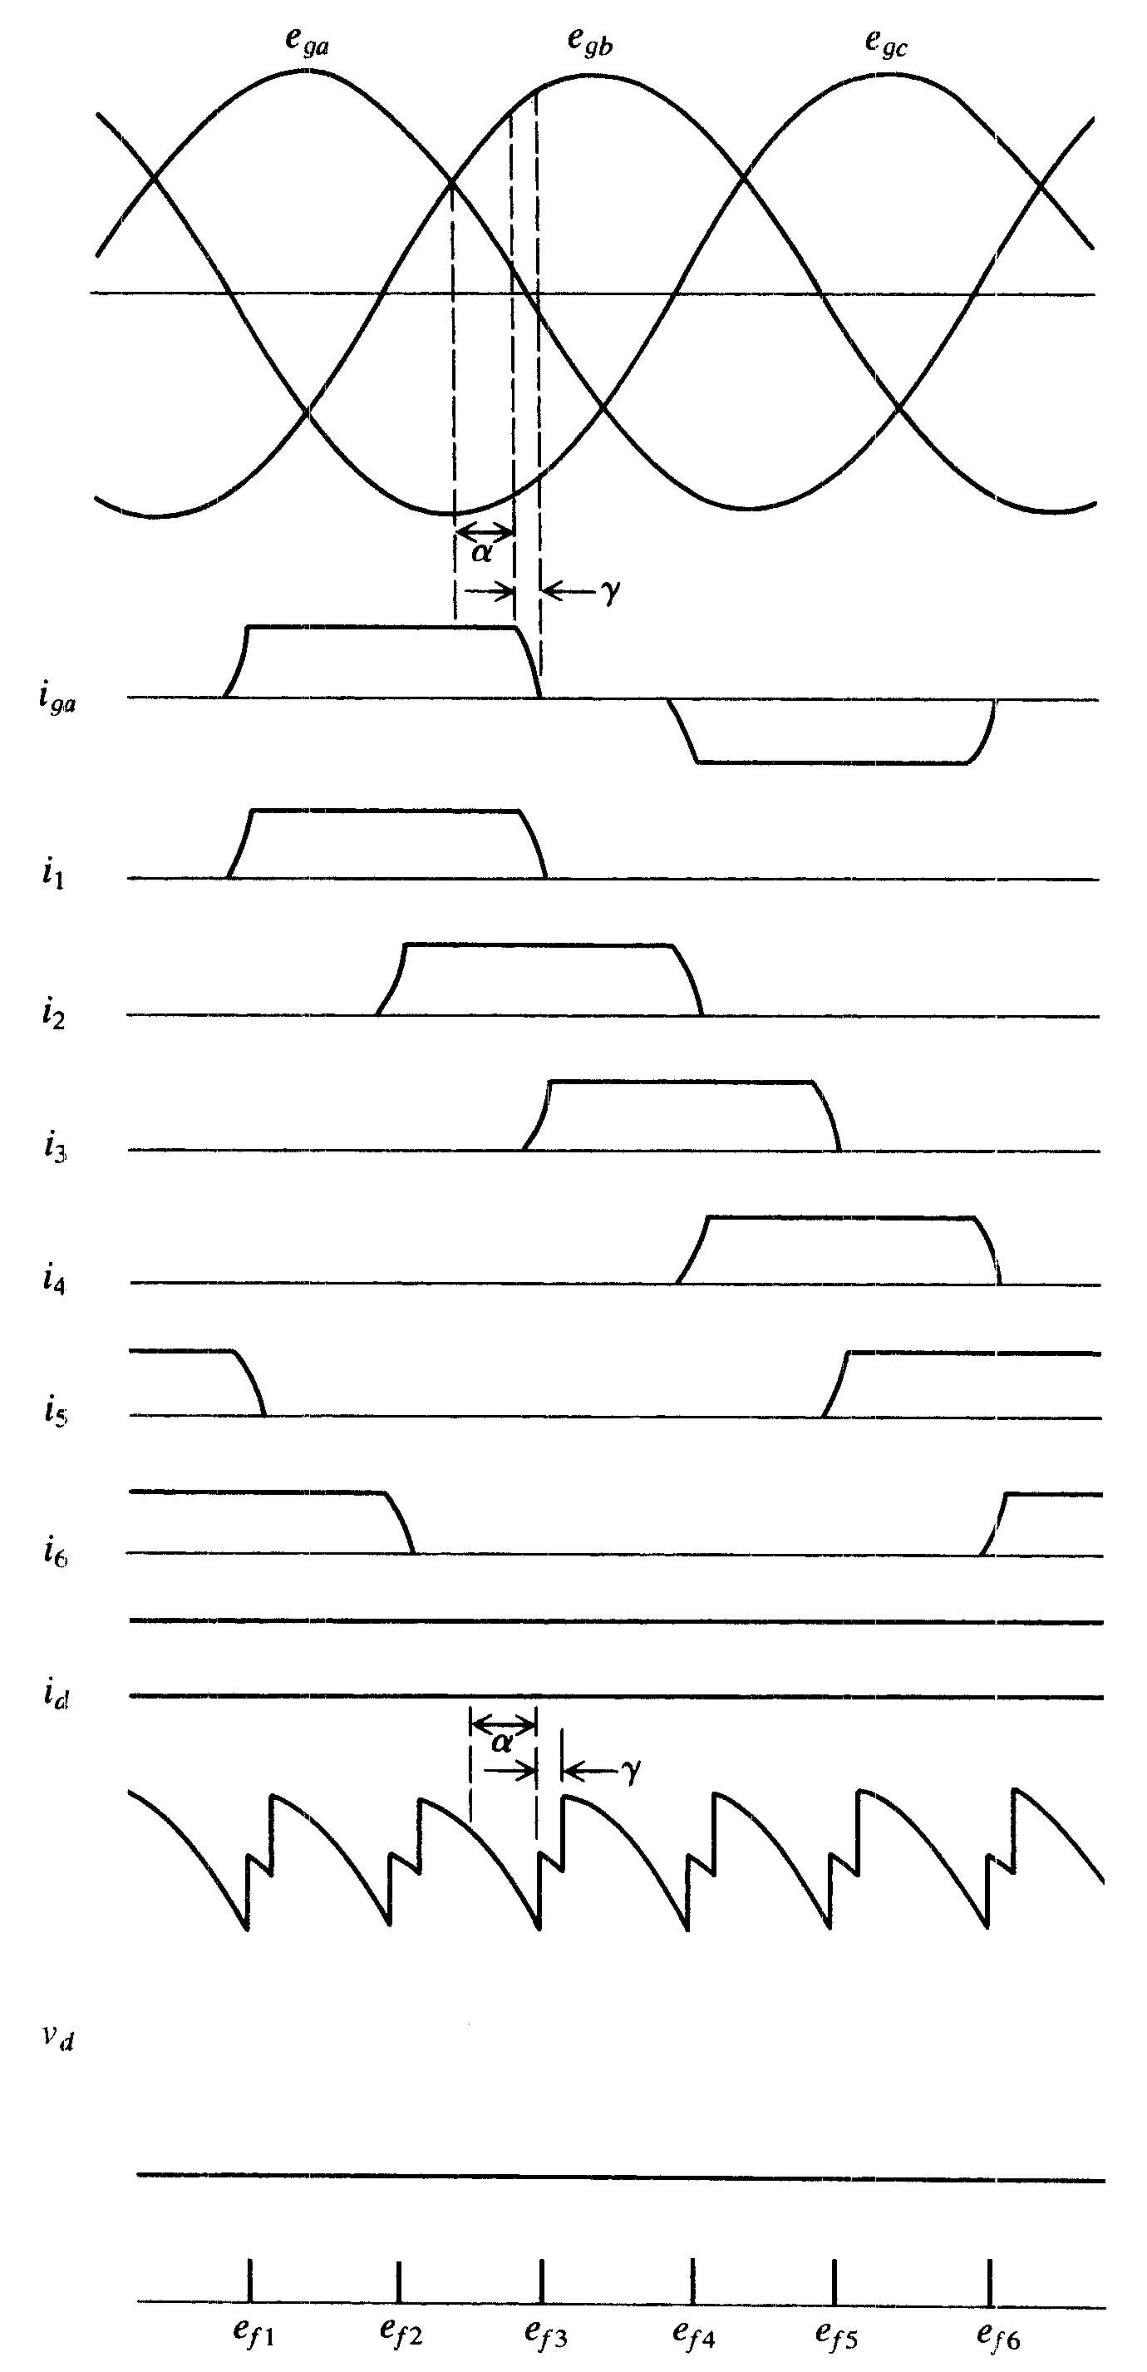
Operation with Phase Delay and lc
Assume continuous constant load current i_{d} = I_{d}
During commutation interval γ,
both T1 and T3 are conducting.
The output voltage during this period is:
Taking this into account in the average output voltage, it can be shown that:

Slide 7
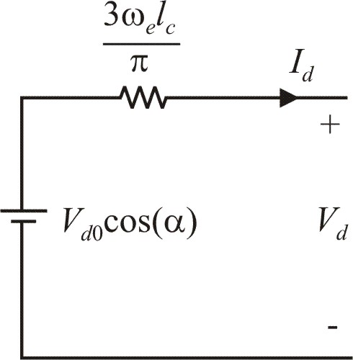
Equivalent Drive Average Model

Slide 8
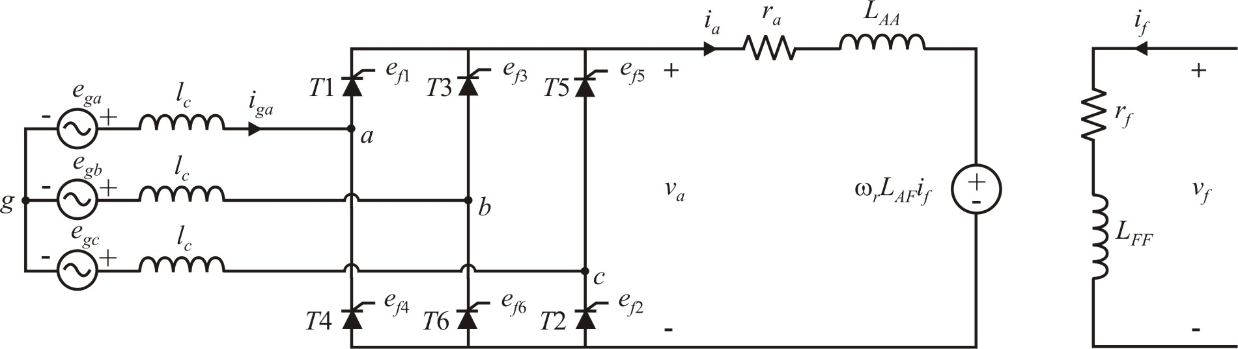
DC Drive Example
Three-phase source
200-hp DC Motor

Slide 9
Example Parameters

Slide 10
Calculations with α = 0 and ω_{r} = 69.6 rad/s

Slide 11
SCR Drive Simulation

Slide 12
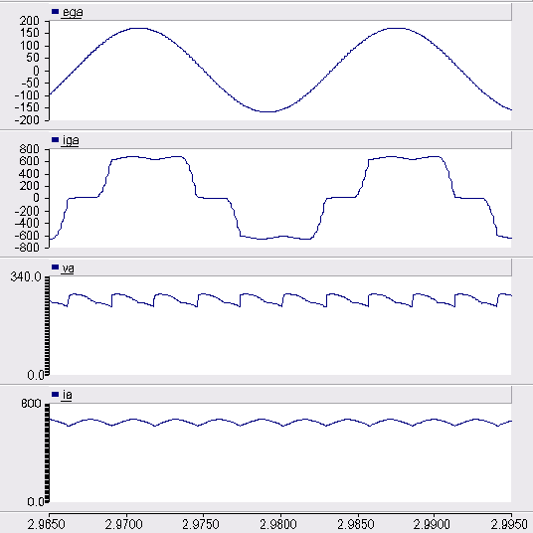
Simulation with α = 0 and ω_{r} = 69.6 rad/s
matches book example, see Figure 12.3-10

Slide 13
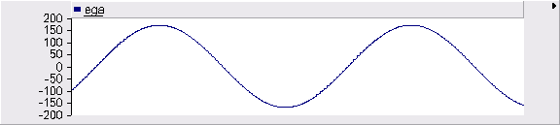
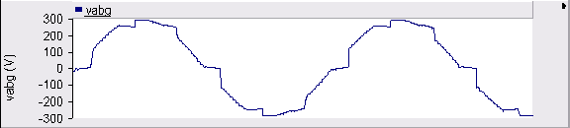
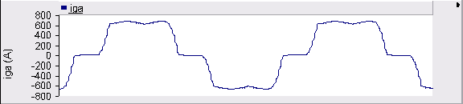
Simulation with α = 0 and ω_{r} = 69.6 rad/s

Slide 14
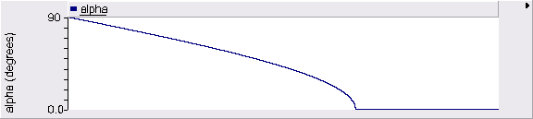
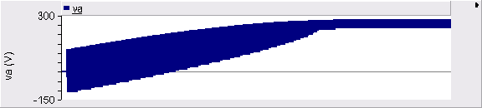
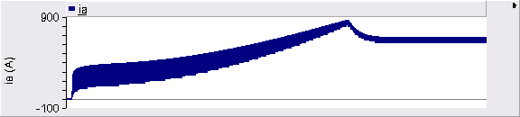
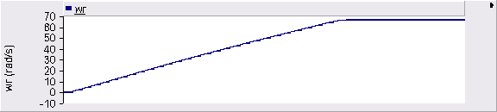
SCR Drive Startup

Slide 15
Calculations with α = 21.6º and ω_{r} = 64.6 rad/s

Slide 16
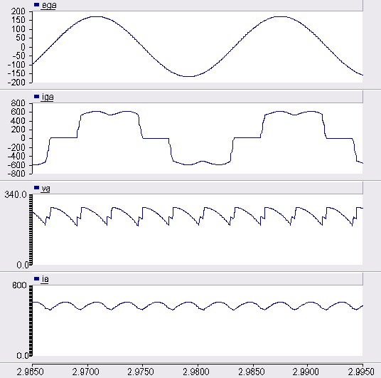
Simulation with α = 21.6º and ω_{r} = 64.6 rad/s
matches book example, see Figure 12.3-12

Slide 17
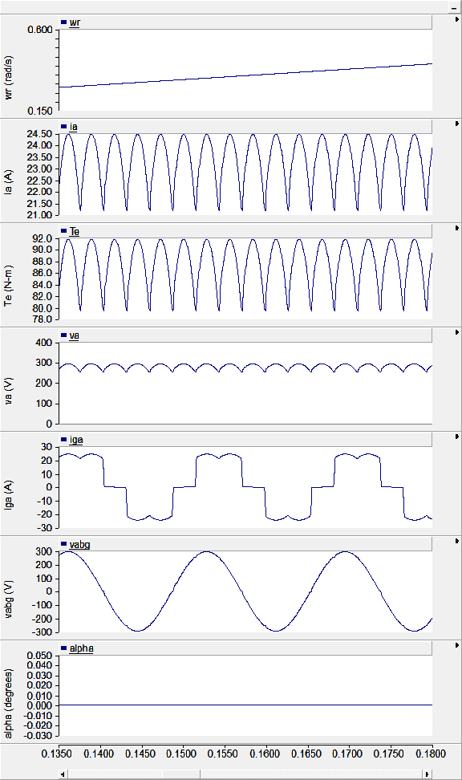
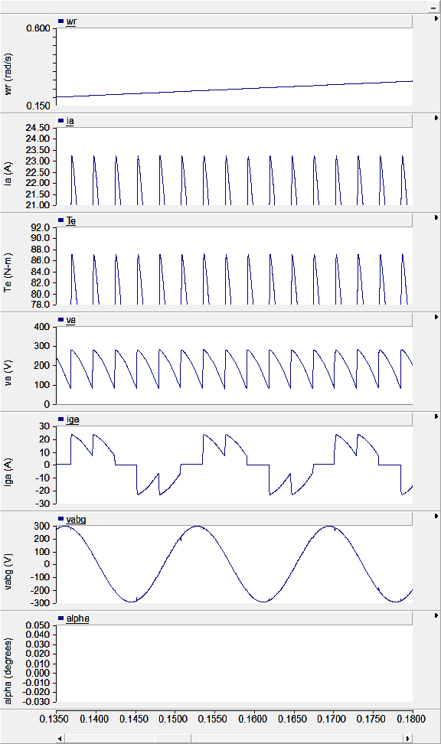
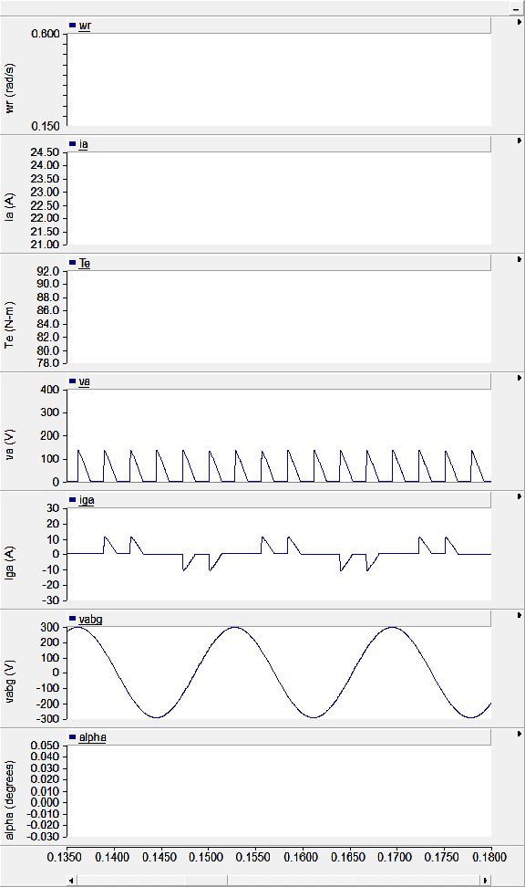
SCR Drive Modes of Operation
waveforms can be very different for different operating conditions
α = 0
α = 45º
α = 90º

Slide 18
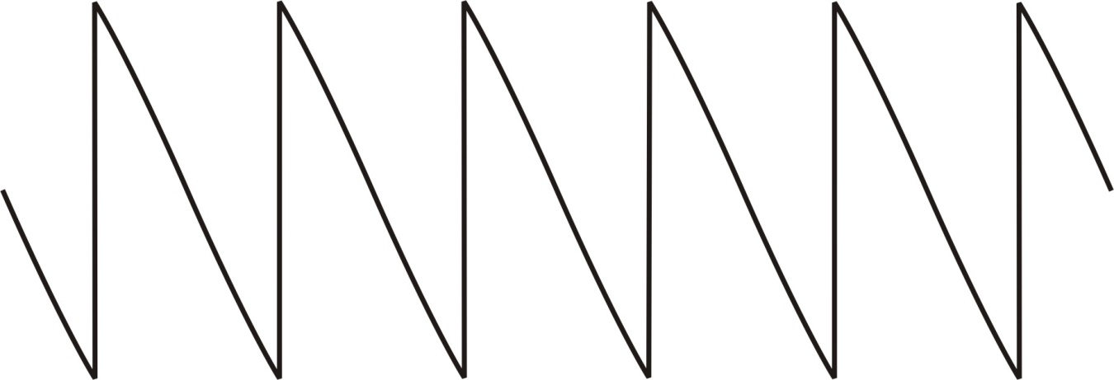
Zero Voltage Operation (α=90º)

Slide 19
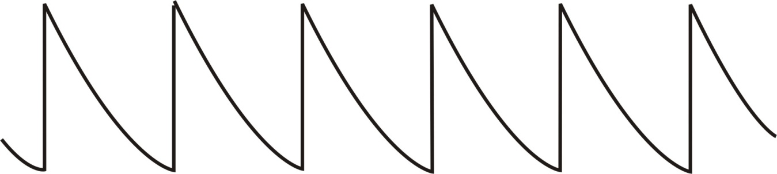
Negative Voltage Operation (α>90º)

Slide 20
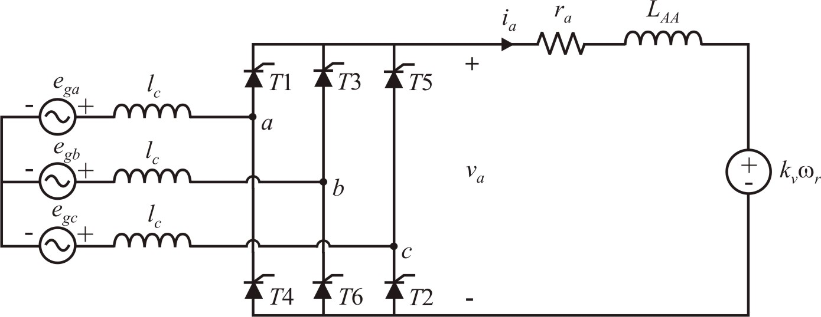
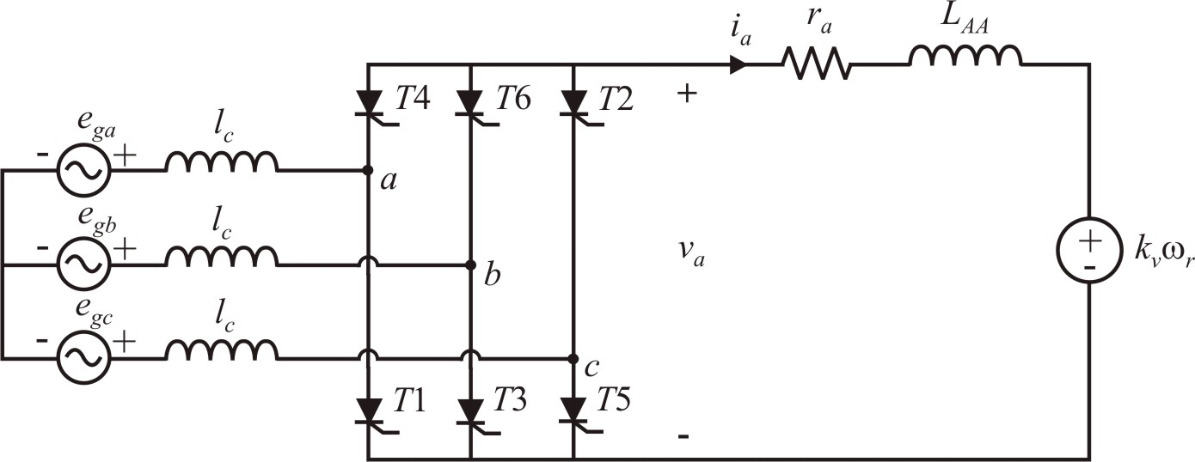
Regenerative Operation

Slide 21
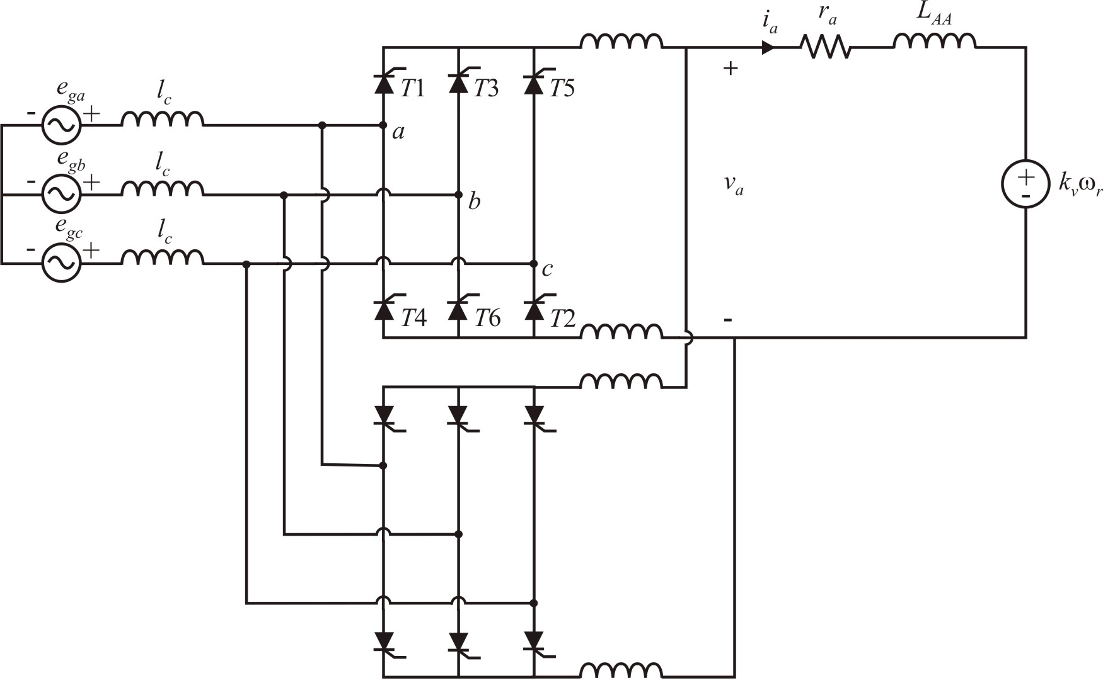
Four-Quadrant SCR Drive

Slide 22
Four-Quadrant SCR Drive Simulation

Slide 23
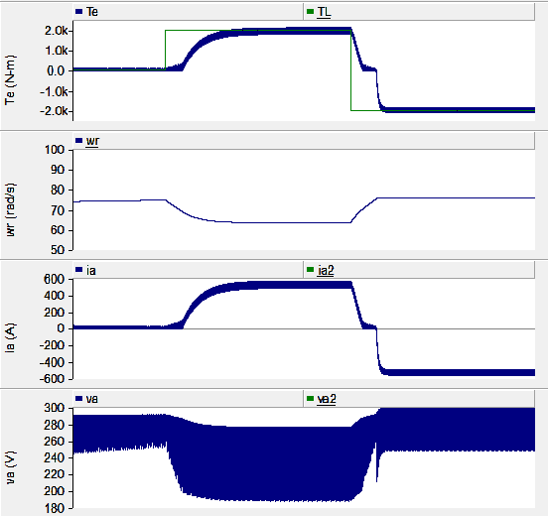
Four-Quadrant SCR Drive Waveforms

Slide 24
SCR Drives
Operation with phase delay allows a wide range of control over the output voltage
Commutating inductance reduces the output voltage. An average-value model to account for this was presented. More elaborate average-value models can be developed including computation of the fundamental component of ac side currents.
Operation with negative voltage is possible by extending the firing angle beyond 90 degrees
Two SCR drives can be placed together to form a four-quadrant drive

Slide 25
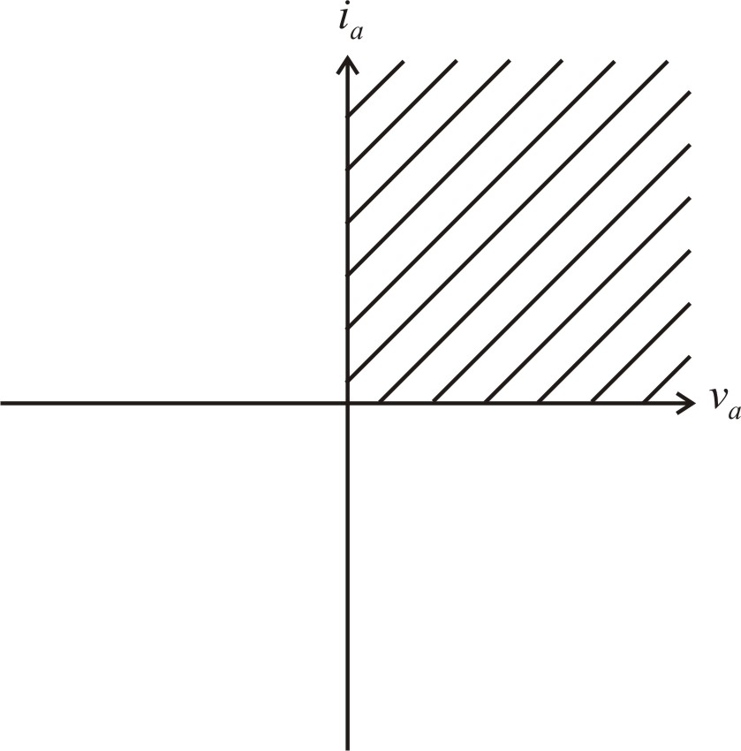
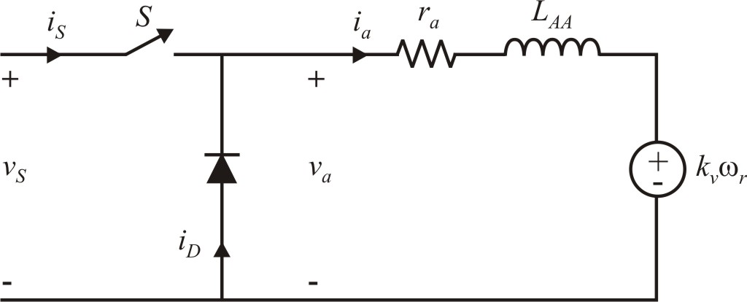
One-Quadrant PWM Dc Drive (Chapter 12)

Slide 26
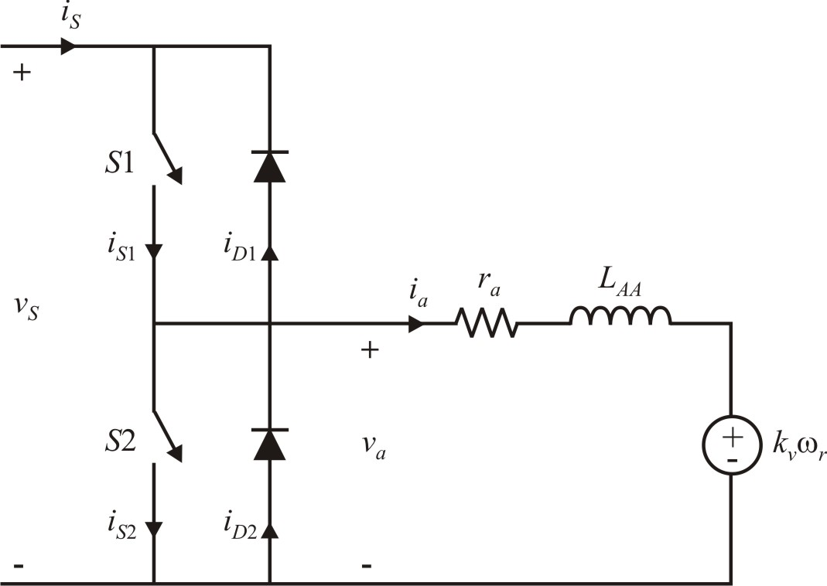
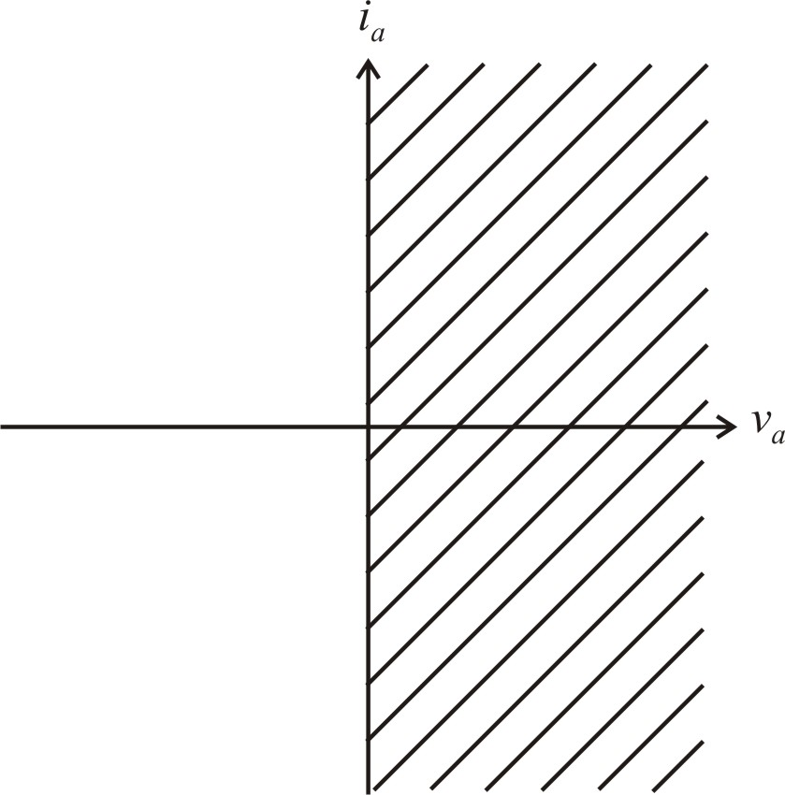
Two-Quadrant PWM Dc Drive

Slide 27
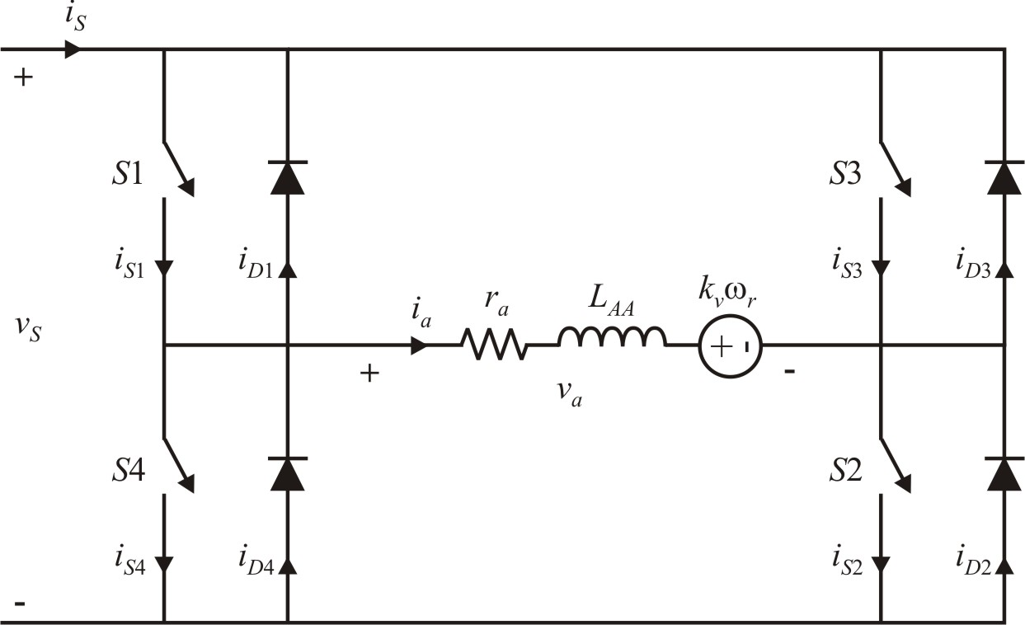
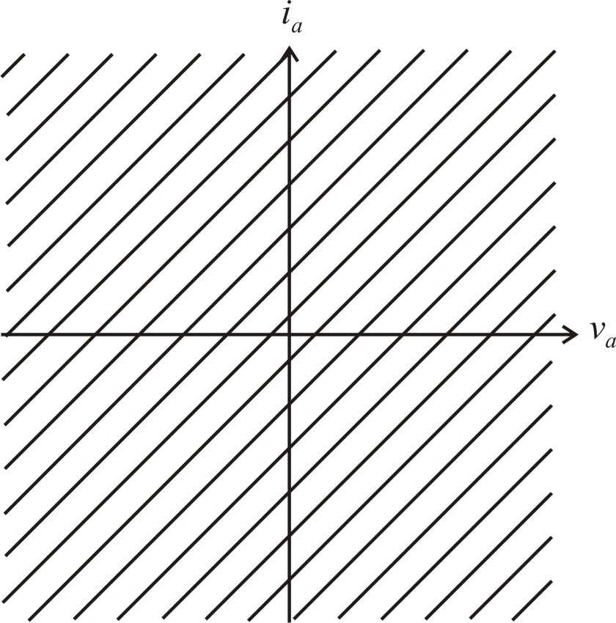
Four-Quadrant PWM Dc Drive

Slide 28
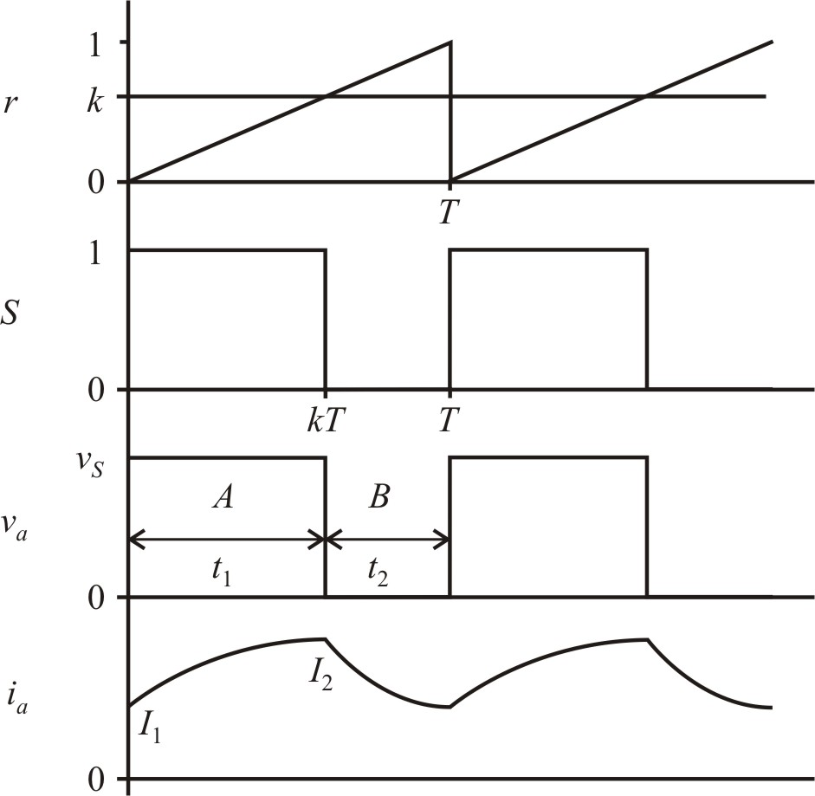
One-Quadrant Drive Waveforms
switching frequency
switching rules
steady-state equations

Slide 29
Interval A
- steady state solution
- transient state
for

Slide 30
Interval B
define
for

Slide 31
At ,
At ,
two equations with two unknowns

Slide 32
Approximate Equations for I₁ and I₂
From the book, when T << τ_{a} is small,
Taylor series
with small x,
From buck converter equations if r_{a} is small,

Slide 33
current ripple
maximum current ripple

Slide 34
Calculation Example

Slide 37
Simulink Example

Slide 38
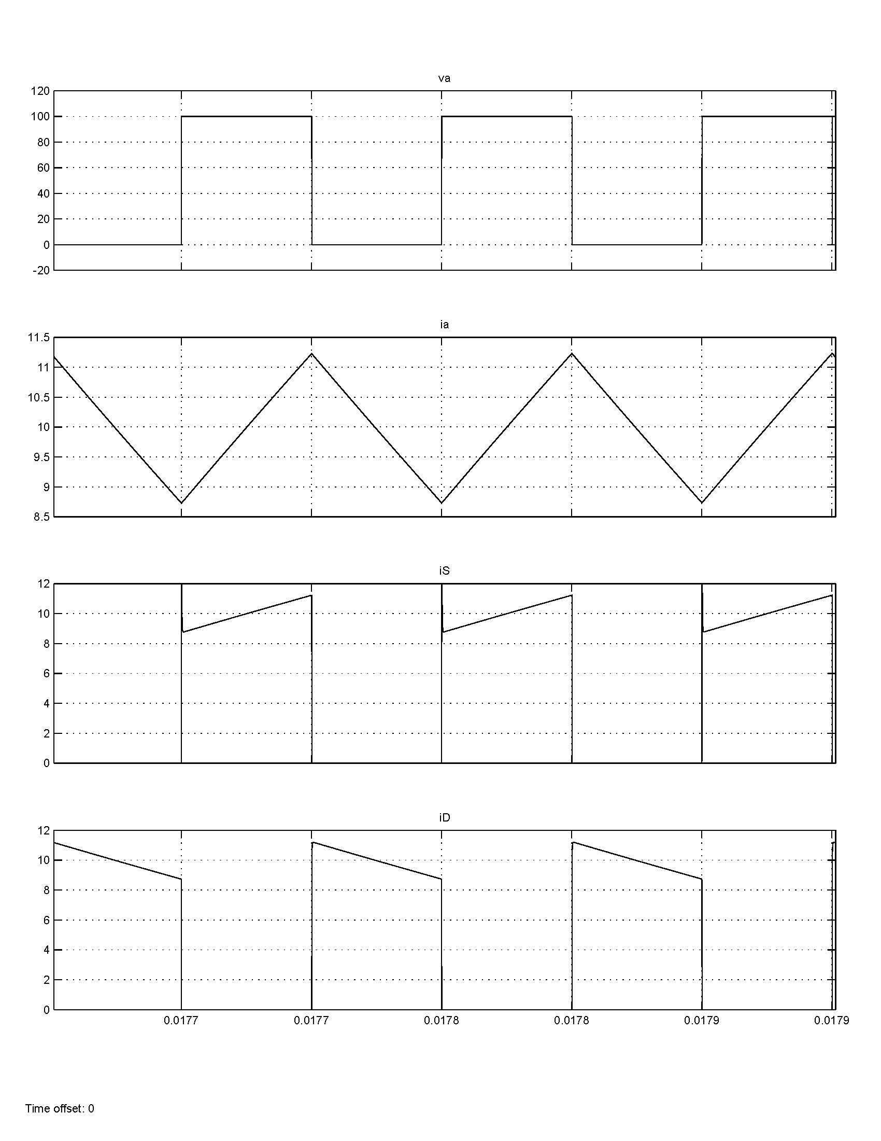
Simulink Waveforms

Slide 39
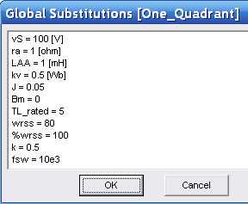
PSCAD Example

Slide 40
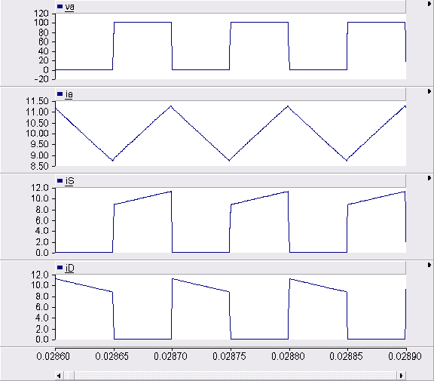
PSCAD Waveforms

Slide 41
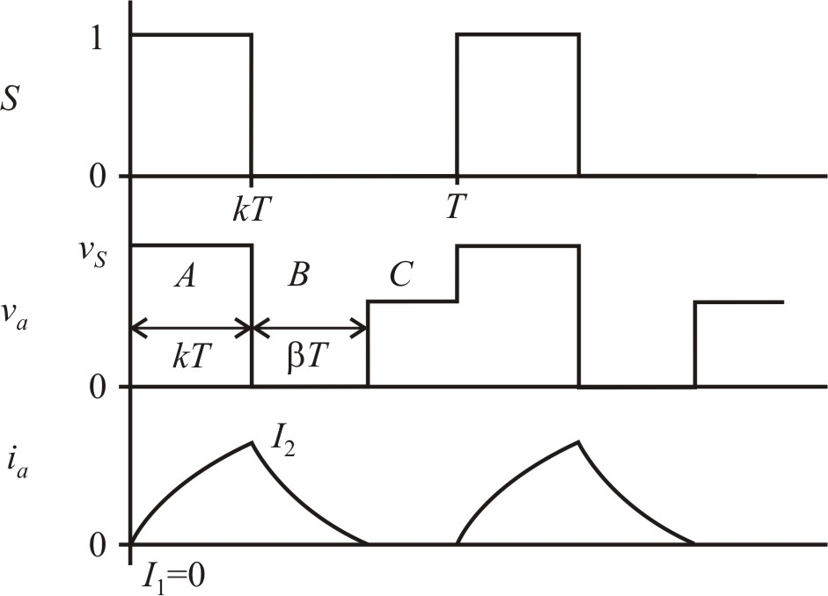
Discontinuous Operation
interval A (from before with I₁=0)
at ,

Slide 42
interval B (equation from before)
at or

Slide 43
Discontinuous Mode Example

Slide 45
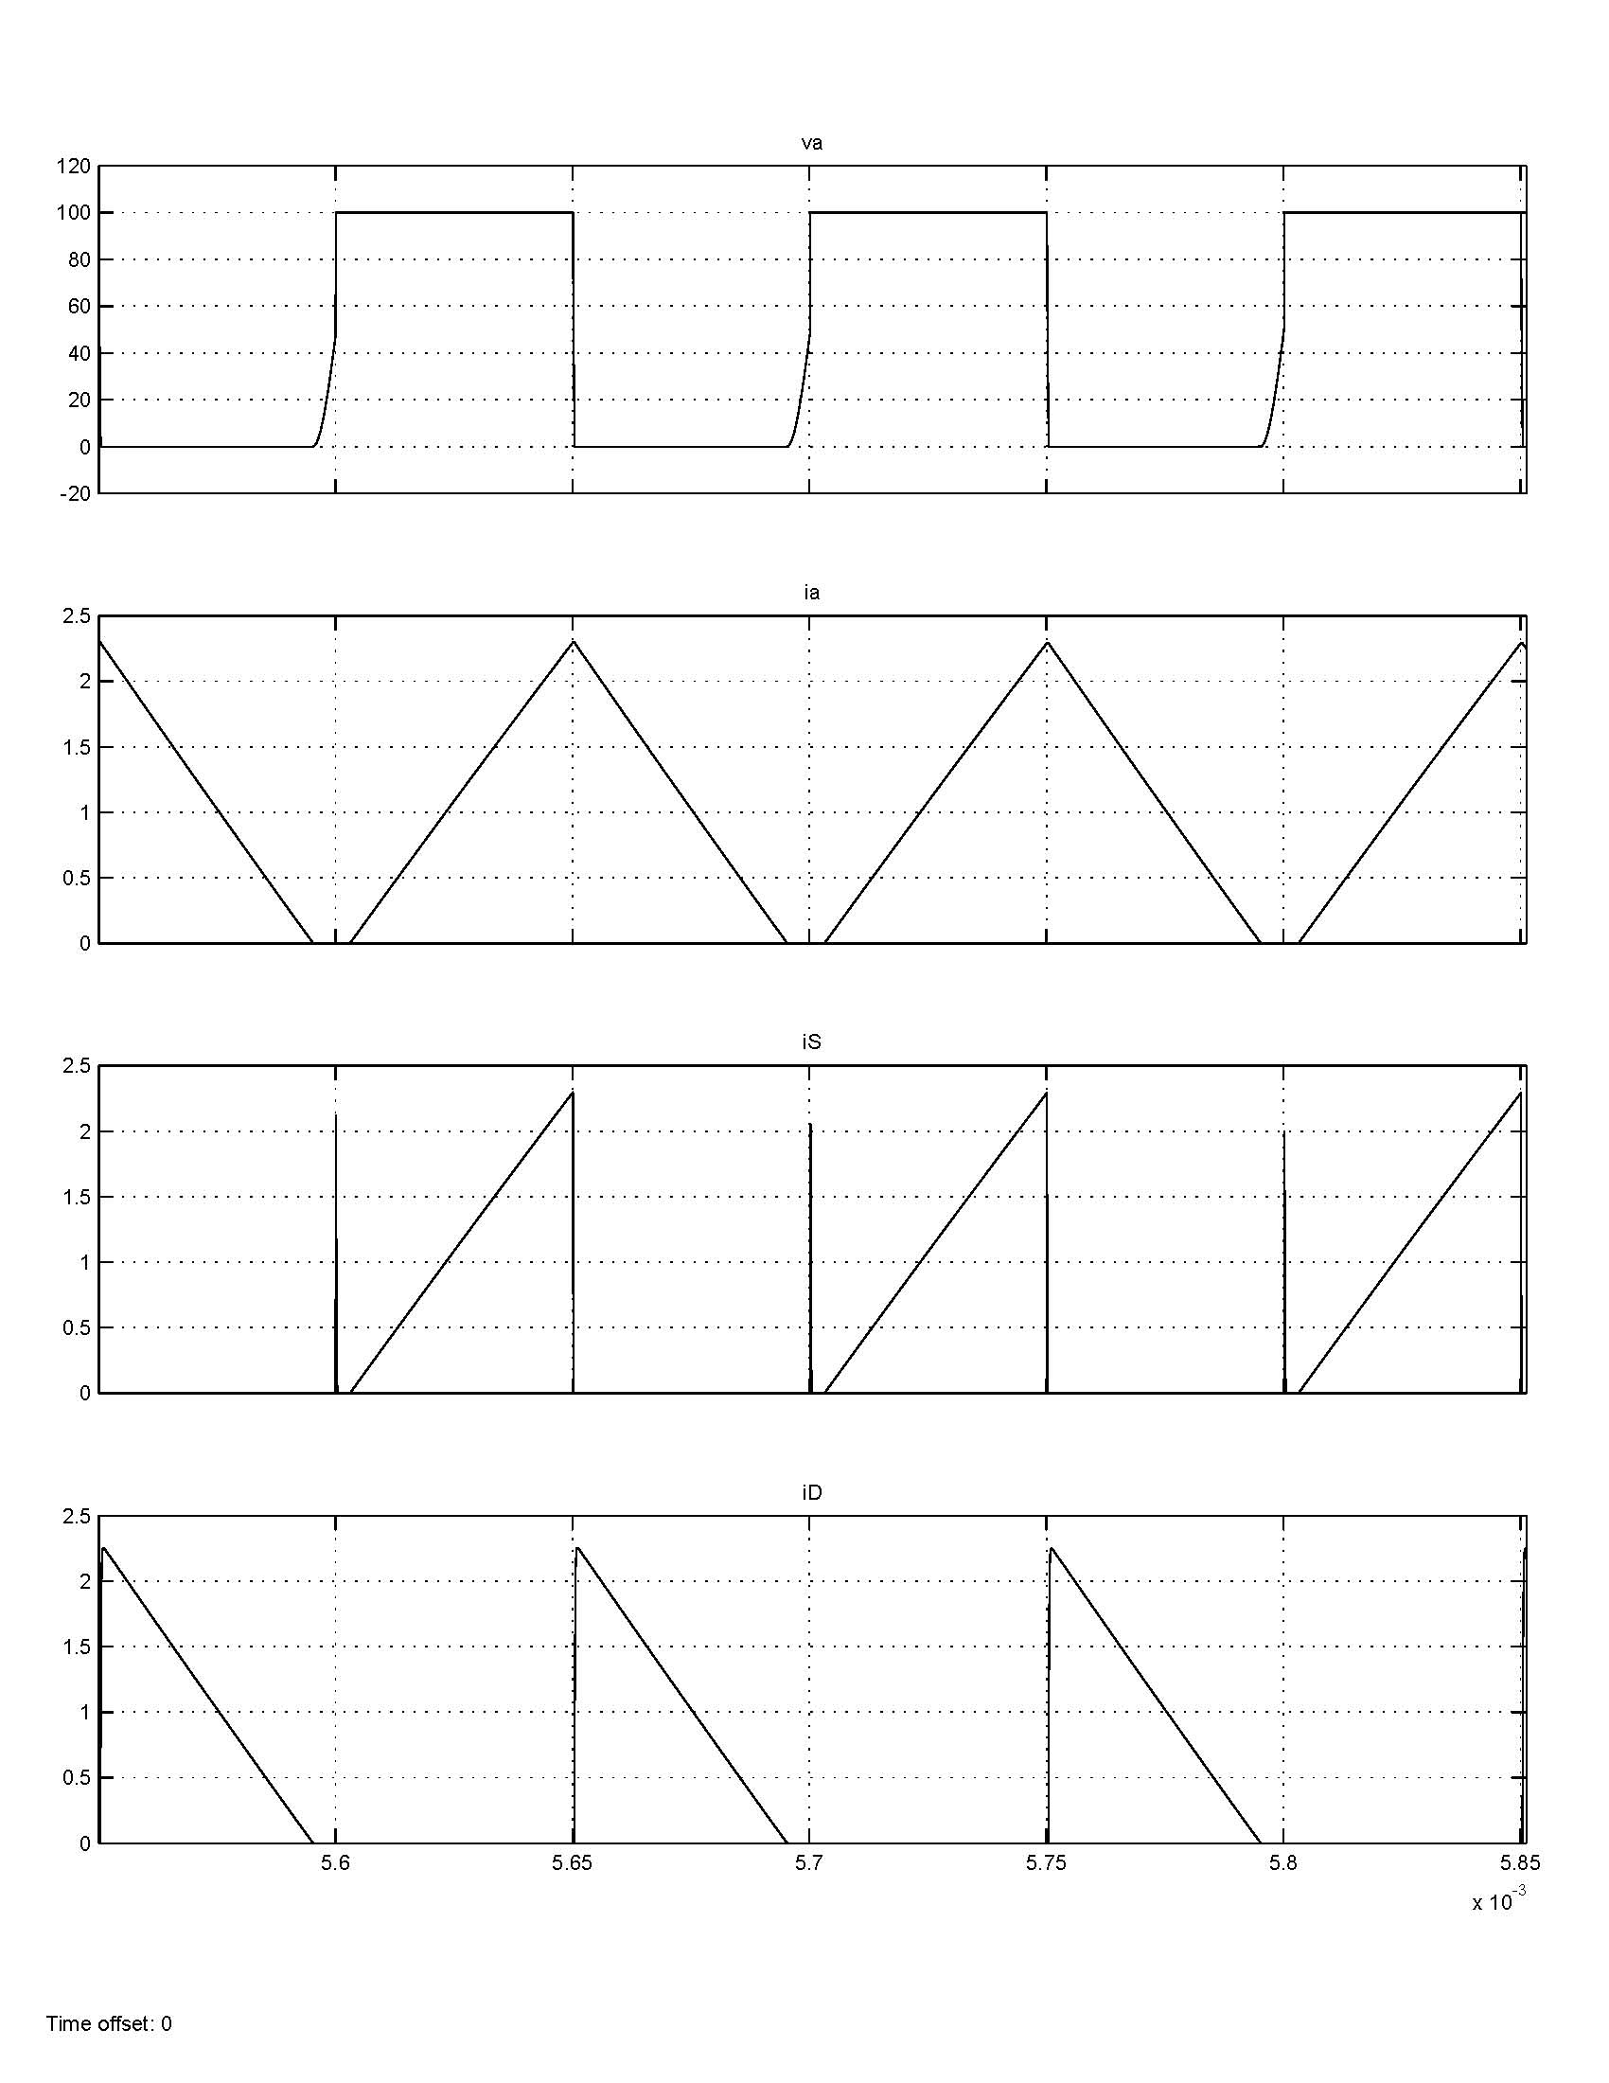
Simulink Discontinuous Waveforms

Slide 46
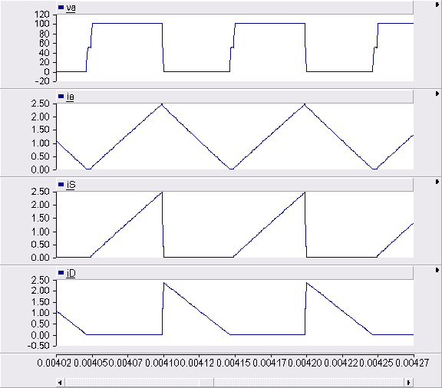
PSCAD Discontinuous Waveforms

Slide 47
Dynamic Average-Value Motor Model
variable , but slower than T
average equations over last cycle of T
motor equations are linear, so they maintain their form

Slide 48
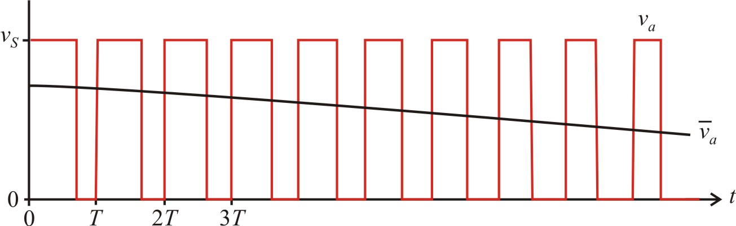
Dynamic Average-Value Drive Model (continuous mode)
slowly varying k (compared to T)
also,

Slide 49
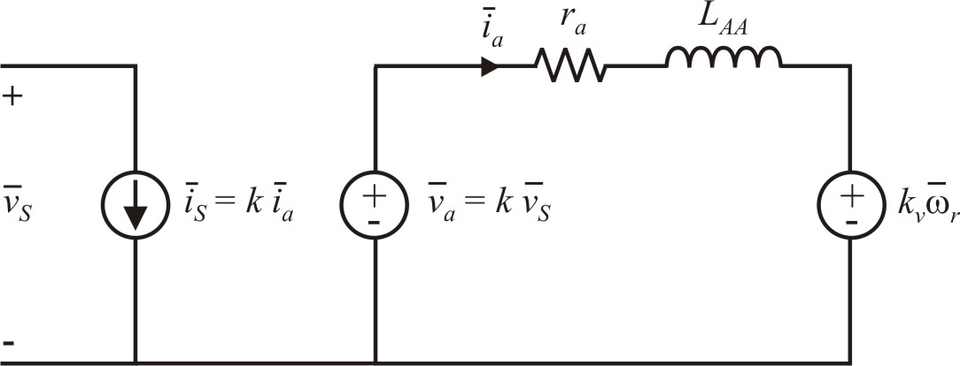
Average-Value Model
drive
motor
Can also incorporate the average-value drive model into a system with
changing mechanical loads
motor drive torque, speed, or position control

Slide 50
One-Quadrant Dc Drive (Detailed Model)

Slide 51
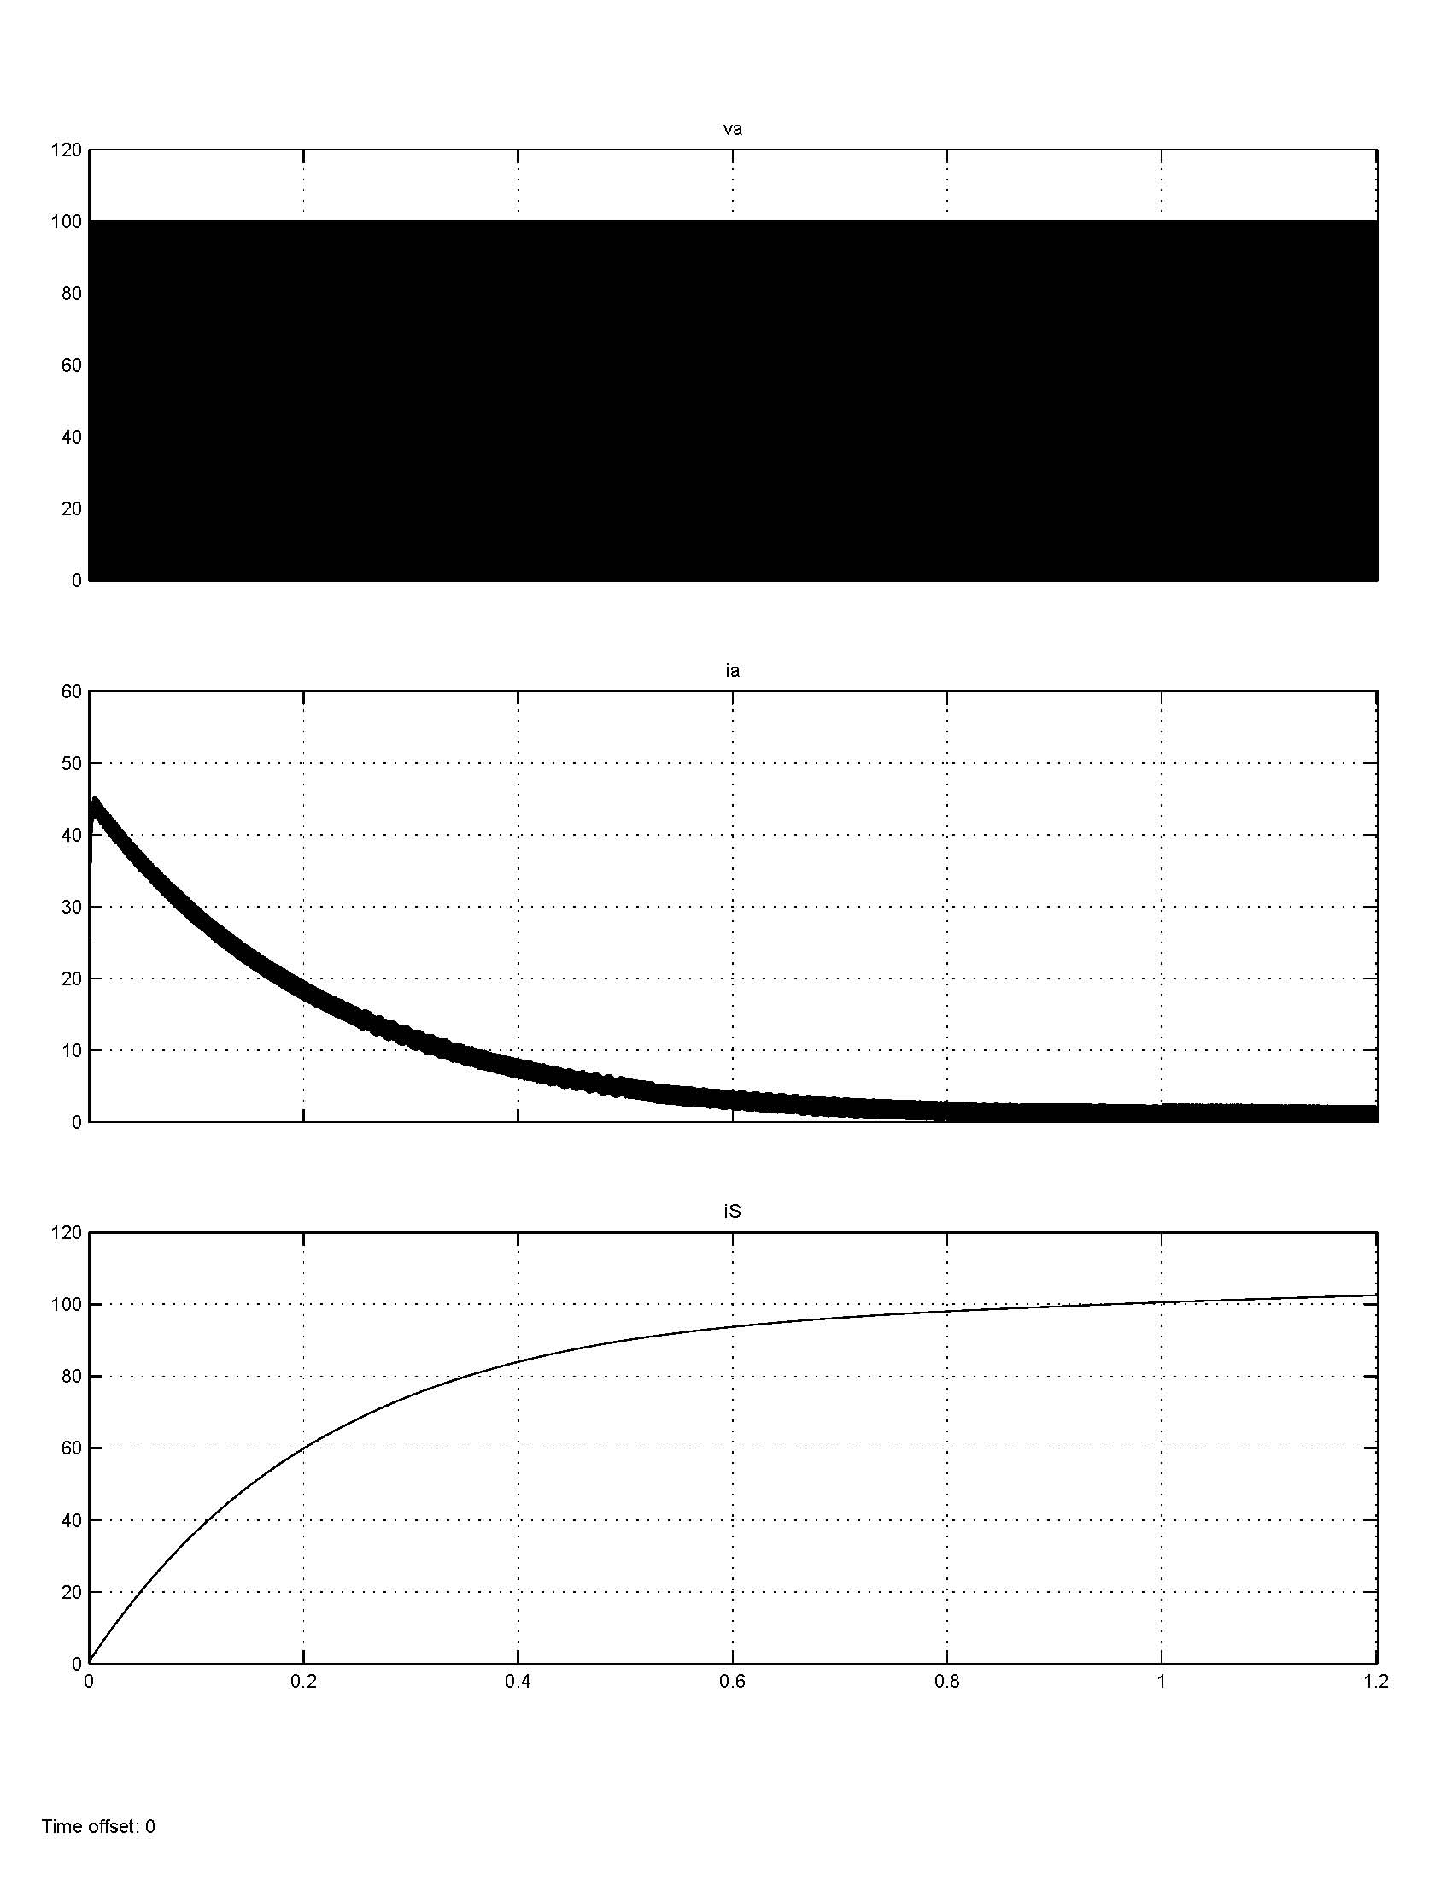
Detailed Simulation Waveforms
time step: 1 microsecond
total time: 1.2 seconds
simulation time: 31 seconds

Slide 52
One-Quadrant Dc Drive (Average-Value)

Slide 53
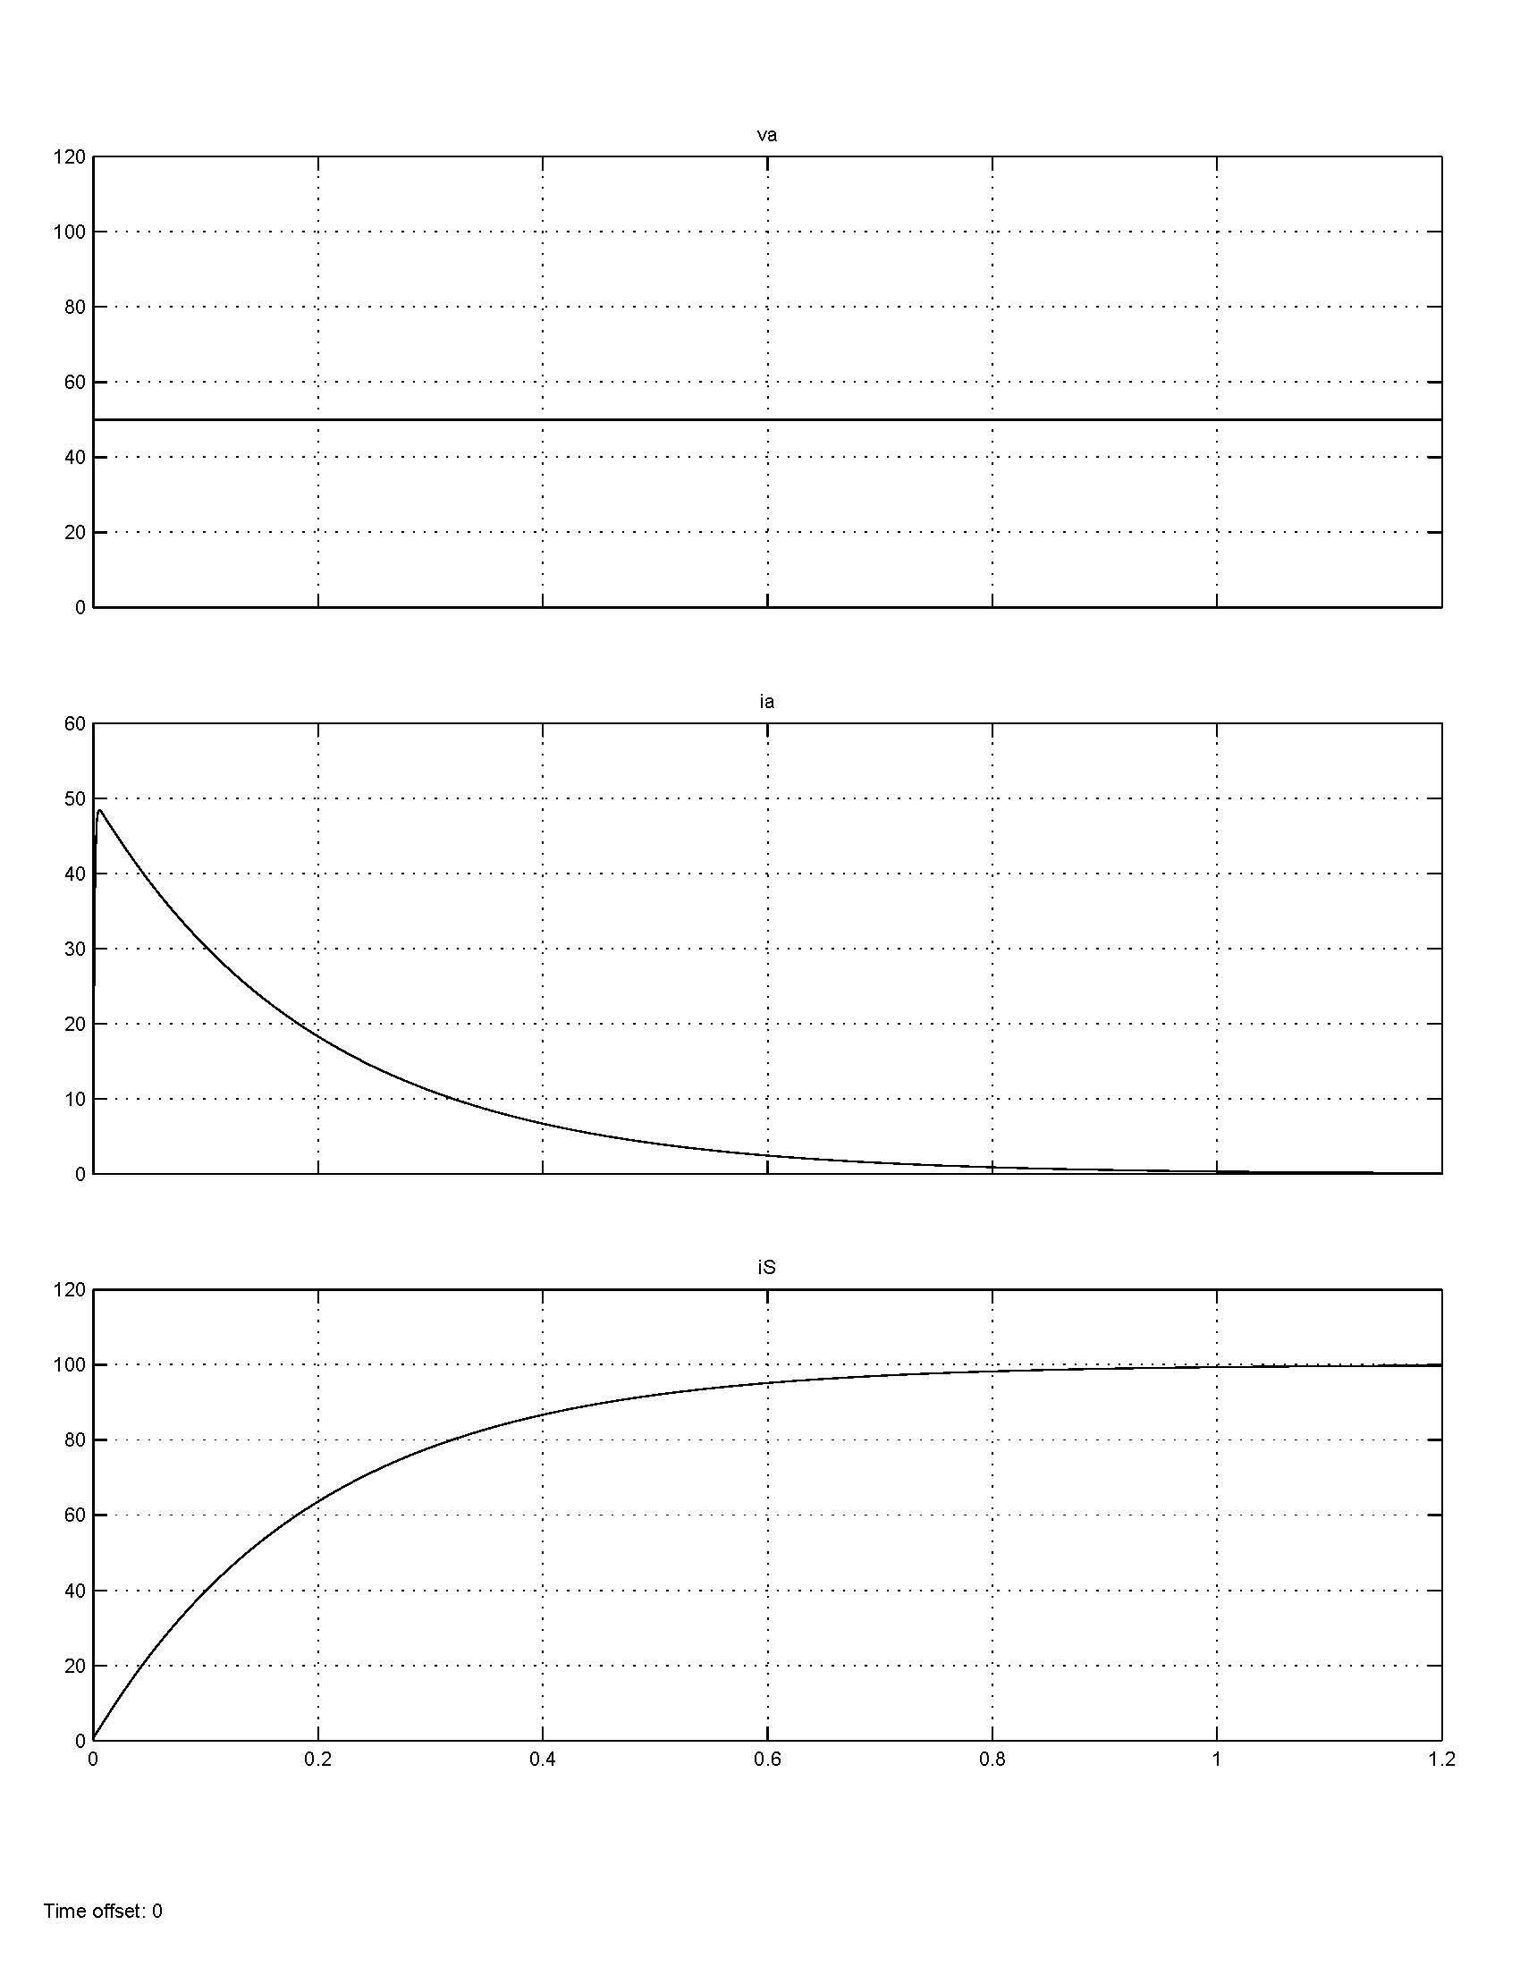
Average-Value Simulation Waveforms
time step: 10 to 1000 microseconds
total time: 1.2 seconds
simulation time: << 1 second

Slide 54
Two-Quadrant Drive Equations
control for S1 is PWM as with one-quadrant drive
Equations for the two-quadrant drive are identical to those of the one-quadrant drive in continuous mode.
Armature current i_{a} can be negative as long as the source can absorb it (I_{S} < 0).

Slide 55
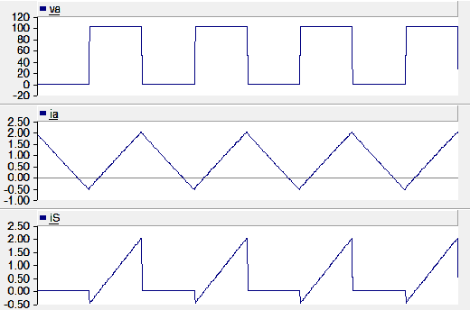
Non-Regenerative Source (Solutions)
1. Capacitor (works for I_{a} > 0)

Slide 56
Non-Regenerative Source (Solutions)
2. Braking circuit

Slide 57
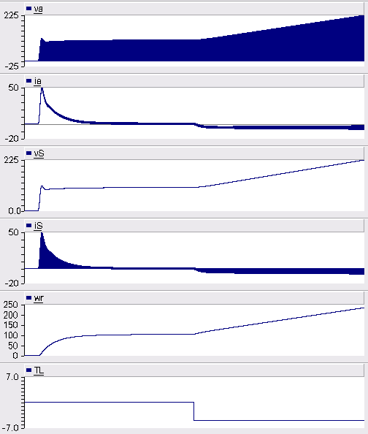
Drive Waveforms without Breaking Resistance

Slide 58
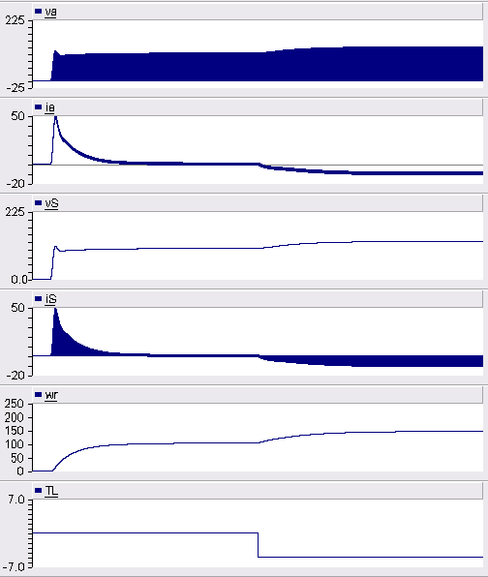
Drive Waveforms with Breaking Resistance

Slide 59
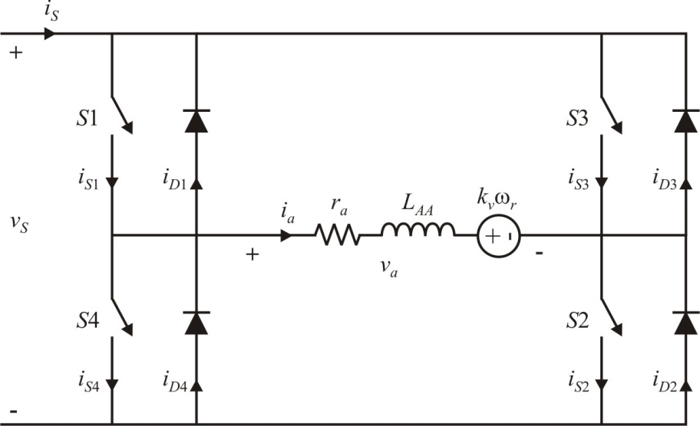

Four-Quadrant DC Drive
switching control

Slide 60
Four-Quadrant Dc Drive Equations
steady-state equations
power:
maximum and minimum currents

Slide 61

Dynamic Average-Value Model
drive
motor

Slide 62

Hysteresis Control
switch transistors based on current

Slide 63
Hysteresis Control Current Limit
for a commanded current, compute a "commanded" voltage using the steady-state motor equations
this must be less than the maximum voltage the drive can supply
for a four-quadrant drive
for one- and two-quadrant drives
otherwise, the drive can not maintain tracking of commanded currents

Slide 64
Example Calculations

Slide 65

Book Example: Loss of Current Tracking
PSCAD exercise: change the one-quadrant drive voltage-source control simulation to a four-quadrant drive with hysteresis current regulation

Slide 66
PWM Drives
One-quadrant drive
one active switch for implementation
only positive voltage and current
Two-quadrant drive
"half-bridge" topology
can support positive and negative currents
breaking resistance for unidirectional sources
Four-quadrant drive
"full bridge" topology
four-quadrant electrical and mechanical operation
breaking resistance for unidirectional sources
Average-value models
fast simulation
does not depict switching (transistor voltages and currents)
good for system simulation and tuning control parameters
can be combined with transfer function models

Slide 67

Dc Drive Example 1
Voltage source
Speed control
4-quadrant

Slide 68

Dc Drive 1 Average-Value Model
similar to the book example of a one-quadrant drive
see Figure 12.7-1

Slide 69
Steady-State Calculations

Slide 70

Dc Drive 1 Dynamic Waveforms
K_{p} = 1 s
K_{i} = 0.5

Slide 71

Dc Drive 1 Steady-State Waveforms
K_{p} = 1 s
K_{i} = 0.5

Slide 72

Dc Drive Example 2
Current-regulated
Speed control
4-quadrant
hysteresis control, Figure 12.8-2 in book

Slide 73

Dc Drive 2 Average-Value Model
PMDC reduced-order model (ROM)

Slide 74

Dc Drive 2 Dynamic Waveforms
K_{p} = 50 A∙s
K_{i} = 10 A
ε = 1.6 A

Slide 75

Dc Drive 2 Steady-State Waveforms
K_{p} = 50 A∙s
K_{i} = 10 A
ε = 1.6 A

Slide 76

Dc Drive Example 3
Voltage-source with inner current loop
Speed control
4-quadrant

Slide 77

Dc Drive 3 Dynamic Waveforms
K_{p1} = 100 N∙m∙s
K_{i1} = 20 N∙m
K_{p2} = 100 1/A
K_{i2} = 20 s/A

Slide 78

Dc Drive 3 Steady-State Waveforms
K_{p1} = 100 N∙m∙s
K_{i1} = 20 N∙m
K_{p2} = 100 1/A
K_{i2} = 20 s/A

Slide 79

Dc Drive Example 4
Current-regulated (delta PWM)
Speed control
4-quadrant

Slide 80

Dc Drive 4, Delta Control

Slide 81

Dc Drive 4 Dynamic Waveforms
K_{p} = 50 A∙s
K_{i} = 10 A
f_{clock} = 60 kHz

Slide 82

Dc Drive 4 Steady-State Waveforms
K_{p} = 50 A∙s
K_{i} = 10 A
f_{clock} = 60 kHz

Slide 83
Dc Drive Examples
Dc drive examples demonstrate
speed control
hysteresis current regulation (Drive 2)
voltage source PWM with inner current loop (Drive 3)
delta current regulation (Drive 4)

Slide 84

Classical Control System
r - reference
e - error
x - plant input
y - plant output
C(s) - controller transfer function
G(s) - plant transfer function

Slide 85
Second-Order System
= natural frequency (rad/s)
= damping ratio
poles:
stability: and
critically damped: or

Slide 86
Dc Control System Example 1
Proportional control:
Voltage-source drive:
Speed control:
PMDC motor with T_{L}=0:

Slide 87
Dc Control System 1, Drive Model
Drive average-value model: 4 - quadrant
non-linear

Slide 88
Dc Control System 1, Transfer Function

Slide 89
Dc Control System 1 Example

Slide 90
Dc Control System 1 Poles

Slide 91
Dc Control System 1, Critical Gain

Slide 92
Dc Control System Example 2
PI Control:
Current-regulated drive:
Speed control:
PMDC motor with fan load:

Slide 93
Dc Control System 2, Equations
linearize

Slide 94
Dc Control System 2, Transfer Function

Slide 95
Dc Control System 2, Example

Slide 96
Dc Control System 2, Poles

Slide 97
Dc Control System 2, Critical Gain

Slide 98

Dc Control System 2 Waveforms, Low Gain
commanded speed stepped from 200 rad/s to 250 rad/s

Slide 99

Dc Control System 2 Waveforms, Critical Gain
commanded speed stepped from 200 rad/s to 250 rad/s

Slide 100

Dc Control System 2 Waveforms, High Gain
commanded speed stepped from 200 rad/s to 250 rad/s

Slide 101

Dc Control System Example 3
PI control, current-regulated drive
Vehicle system: two inputs use linearization
types of studies
start-up (servo):
step in load (regulator):

Slide 102

Vehicle System
F_{L} - load force (N)
v - vehicle velocity (m/sec)
M - vehicle mass (kg)
g - acceleration constant, g = 9.8 m/sec²
R - wheel radius (m)
φ - incline angle (rad)
D - vehicle friction and windage constant (kg/sec)

Slide 103
Vehicle Equations
motor mechanical equation
assuming no tire slip

Slide 104
DC Control System 3, Transfer Function

Slide 105
Dc Control System 3, Example

Slide 106
Dc Control System 3, Poles

Slide 107
Dc Control System 3, Critical Gain

Slide 108

Dc Control System 3 Waveforms, Low Gain
angle stepped from φ = 0 to φ = 15º at 20 seconds

Slide 109

Dc Control System 3 Waveforms, Critical Gain
angle stepped from φ = 0 to φ = 15º at 20 seconds

Slide 110

Dc Control System 3 Waveforms, High Gain
angle stepped from φ = 0 to φ = 15º at 20 seconds

Slide 111
Dc Control Examples
Dc control examples demonstrate
drive system transfer function; including the control, drive, motor, and load
pole location and plots
over-damped, critically damped, and under-damped responses
vehicle system equations

Slide 112

Second-Order System Under-Damped Response
From: C.L. Phillips and R.D. Harbor, Feedback Control Systems, Prentice Hall, 2000.

Slide 113
Analysis and Design Equations
analysis
design
rise time
percent overshoot
settling time
typically, d = 1%, 2%, or 5%

